Slide 1
Welcome to
Volunteer Services
UVA Health

Slide 2
Our Mission
To provide excellence, innovation, and superlative quality in the
within a culture that promotes equity, diversity, and inclusiveness.
training of
health
professionals
1
creation
and sharing of
health knowledge
care of
patients
Notes:
Mission Slide
Explain the Health System Mission

Slide 3
Our Vision
In all that we do, we work to benefit human health and improve the quality of life.
Be Safe Vision:
We are the safest place in health care for patients and team members alike.
Notes:
Welcome Slide
Welcome New Team Members
Introduce Yourself
Explain:
Restrooms
Emergency Procedures
Importance of Group Dynamics
Resources
Orientation Guide
Technology Essentials
ASPIRE Materials
Lunch Coupon
Pride Card
Schedule

Slide 4
Our Values
At UVA Health System, we put the patient at the center of everything we do.
We ASPIRE to create a culture of trust, respect, and engagement through our values:
A
S
P
I
R
E
Accountability
Stewardship
Professionalism
Integrity
Respect
Excellence
Notes:
Values Slide
Provide a high level overview of our ASPIRE values
Explain the importance of living out our values every day

Slide 5
General Requirements
ID badge must be worn at all times, above the waist and visible
Appropriate casual business attire, no jeans, no shorts, no leggings, no open toed shoes or sandals
Perfume/cologne or other strong odors should be limited
Volunteers must sign in/out for their shift
Be dependable. Notify Volunteer Services and site supervisor of schedule changes
Report any criminal conviction within 5 days to your Volunteer Coordinator or face immediate dismissal

Slide 6
Health System
Volunteer Roles for Post Bacc Pre-Med Students

Slide 7
Health System Roles for Post Baccs
Escort & Wayfinding: A customer service position for those who like to walk. Volunteers assist patients and families by walking with them to their first destination. Friendly, gregarious people are wanted in this role. Basic wheelchair training provided. Ask for Kim
Location: Main Hospital Lobby
Hours: Monday – Friday, 3 hours shift 8 am - 5 pm
Patient Deliveries: Volunteers deliver florist arrangements, mail, packages and e-cards to the patient’s bedside, and may visit if the patient desires. This role can be combined with Wayfinding for a full shift of customer service and walking – come and exercise while helping others!
Ask for Kim
Location: Main Hospital Lobby
Hours: Monday-Friday: 1 – 4 PM
Driver, Patient Courtesy Shuttle: Help patients and families navigate across “The Link” between University Hospital and the West Complex, driving a 3-passenger golf cart. A great sit-down job for someone interested in providing great customer service, and saving many steps for frail patients. A valid driver’s license is required. Ask for Kim
Location: Main Hospital Lobby
Hours: Monday–Friday, 3 hour shift between 8 am - 5 pm
Dentistry Assistant: Volunteers assist in the pediatric, dental clinic, escort patients to exam rooms, stock clean supplies and provide administrative support. Ask for Kim
Location: Barry Battle Outpatient Children’s Hospital
Hours: Wednesday, Thursday 9 – 12 n, 1 – 3 PM
Therapy Assistant: Volunteers assist staff and pediatric outpatients/ inpatients receiving Physical/Occupational Therapy Services with patient care activities and routine unit activities. An excellent opportunity to observe and learn about pediatric Physical/Occupational/Speech Therapy. Ask for Kim
Location: Barry Battle Outpatient Children’s Hospital
Hours: Monday– Friday, 9 am – 5 pm (shifts vary)

Slide 8
UVA Cancer Center
Open Roles for Post Bacc Students:
Infusion Hospitality at Emily Couric Clinical Cancer Center
Mon-Friday 7:00AM – 9:00AM (+/- 30 min)
Sat/Sun 9:00AM – 12:00 Noon (+/- 30 min)
Inpatient Oncology/Stem Cell Unit at University Hospital
Weeknights after 5:00pm
Email Maureen Oswald to set up an interview
mmo7u@virginia.edu

Slide 9
Emergency Dept.
Volunteers round on patients providing comfort measures and companionship. Other tasks include:
~ Restocking supplies
~ Running errands and
~ Providing wheelchair transport for patients to other parts of the hospital
Shifts: 7 days a week, 3 hour shifts from 9am to 9pm
Contact LaDelle Gay lh3wn@virginia.edu

Slide 10
Outpatient Surgery Center
Volunteers escort patients and their loved one from the waiting area on the 2nd floor in the Battle Building to their assigned room in the basement surgery suite. They bring family members back up to the waiting are and escort folks to their loved one in the recovery rooms. They round on folks in the waiting areas providing concierge and customer service work. Additional tasks administrative help.
Shifs: M-F between 7am and 6pm
Contact LaDelle Gay
Surgical Family Lounge
Volunteers escort patients and their loved one from the waiting area on the 2nd floor in the main hospital to their assigned room in the surgery suite. They stay with the patient providing instruction on next steps before leaving to let the nurse know they are ready. Between escorts they can assist the staff with making up beds or bed bundles. They round on folks in the waiting areas providing concierge and customer service work.
Shifs: M-F between 5am and 5pm
Contact LaDelle Gay

Slide 11
Transitional Care Hospital
Patient Emissary volunteers round on patients providing bedside friendly visiting, offering comfort measures and companionship as needed. Additional tasks include helping the PT/OT teams, assisting the HUC’s at the nurses station & restocking.
Shifts: 7 days a week between 8am and 8pm
Harmonies for Healing volunteers are musicians who are willing to play gentle healing music for our patients and staff from hallway locations where the music can be heard.

Slide 12
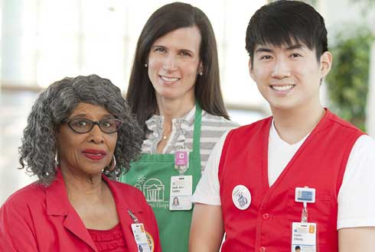
UVA Hospital Auxiliary
Founded in 1908
Supports patients and their families:
by offering aid and comfort
through service
by raising money to support programs at UVA HS
All Volunteers are welcome to attend
Auxiliary Board Meetings

Slide 14
UVA Hospital Auxiliary
Auxiliary Programs supported by fixed contributions:
Music for Healing
Junior Volunteer Program
Madison House Volunteer Program
Flourish, a positive image boutique
Hospitality House lodging facility
Social Work
Lights of Love
Flowers for Patients
Pet Therapy
MERCI

Slide 18
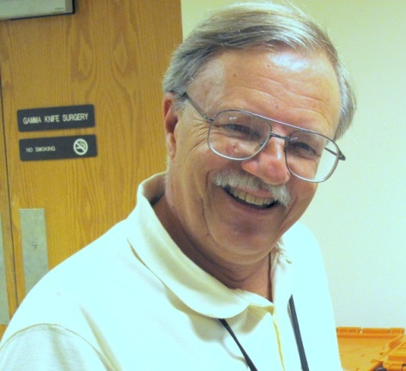
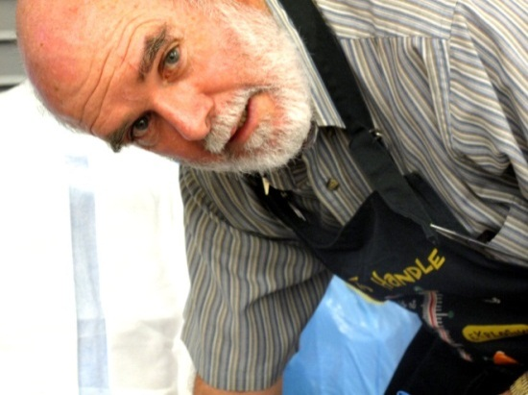
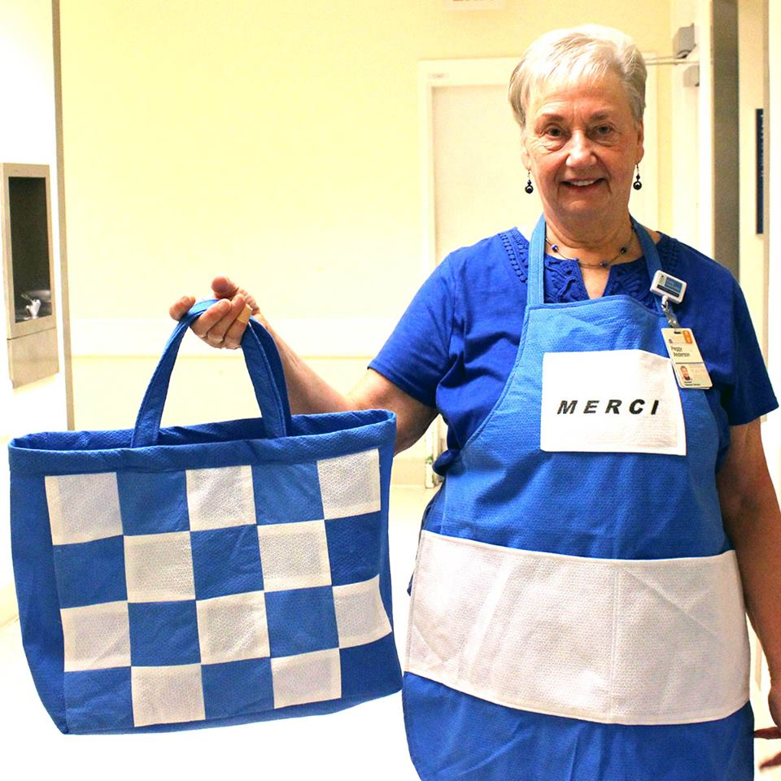
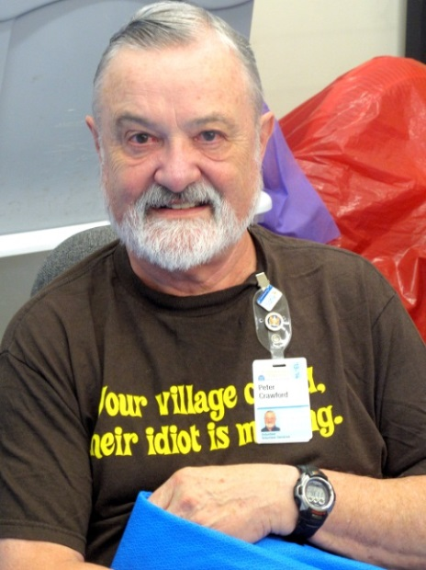
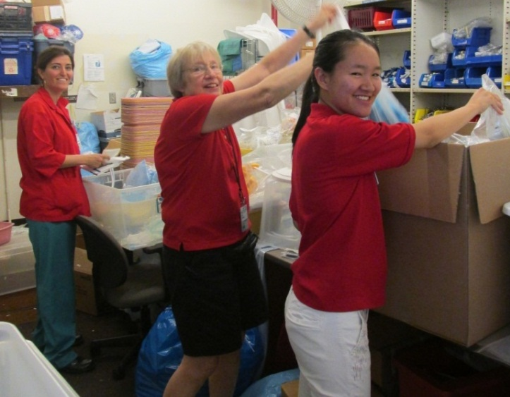
MERCI Medical Equipment Recovery of Clean Inventory
MERCI is a Volunteer run program ~
receive, sort and pack donations for redistribution
Linda Varin (retired UVa OR nurse) Gail Sullivan (retired UVa research faculty) lead the team:

Slide 19
Next Steps:
Contact the Volunteer Coordinator for the role of your choice
ASAP
In July we will opening these roles to UVA undergrads

Slide 21
“I’ve learned that people will forget what you said, people will forget what you did, but people will never forget how you made them feel.”
-Maya Angelou
Volunteers make our patients and their families feel special.
Thank you!

