Slide 1
Pitt Linkage Agreement for UVA PBPM Students
Jillian Golaszewski and Susan salko

Slide 2
Mission of Pitt
Mission Statement
What is their focus?
The mission of the University of Pittsburgh is to improve the health and well-being of individuals and populations through cutting-edge biomedical research, innovative educational programs in medicine and biomedical science, and leadership in academic medicine.
Health & well-being of individuals & populations
Cutting-edge biomedical research
Innovative educational programs
Medicine AND biomedical science
Leadership
Academic medicine
The mission of the University of Southwestern Pennsylvania is to improve the health and well-being of individuals and populations through cutting-edge biomedical research, innovative educational programs in medicine and biomedical science, and leadership in academic medicine.

Slide 3
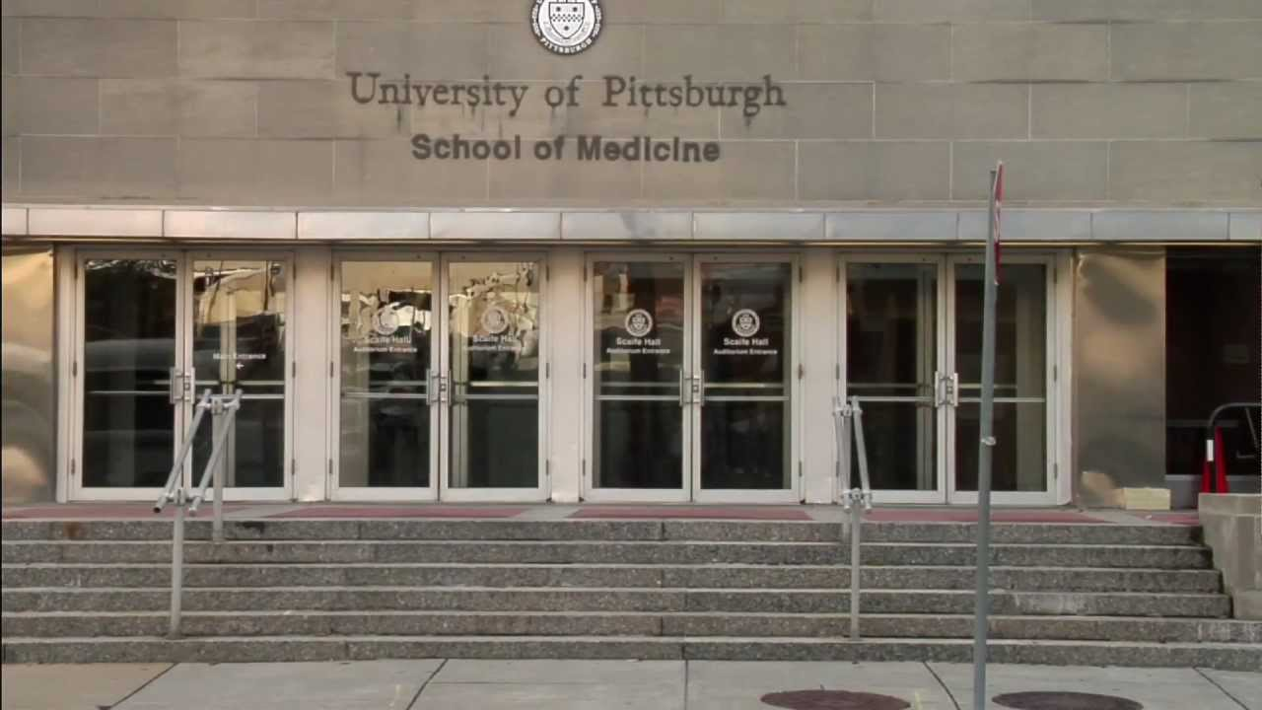
Linkage Visit Opportunities
Pitt Visit Dates
Will be held virtually
***Business casual is appropriate

Slide 4
Pitt Eligibility Criteria
Preferred Undergrad GPA: 3.7
UVA PBPM GPA: 3.75
Required Courses (outside PBPM):
Biochemistry (1 class)
Statistics (1 class)
English, Philosophy, or writing intensive courses (2 classes)
Recommended Course:
Psychology (1 class)

Slide 5
Pitt’s Application Timeline
Commit to Pitt linkage by November
Apply via AMCAS by December 18
Submit Secondary Application & all Recommendation Letters by January 16
Interview invitations extended
Interviews in Pittsburgh in February
Admissions decision released mid-March
Note:
No grade lower than a “B”
Must report Spring grades as soon as available

Slide 6
Risks Involved
Limited number of seats!
Catch-up preparation for MCAT if not accepted
Emotional and mental toll

Slide 7
Ground Rules
If accepted, the linkage agreement is binding & you must attend that medical school
Any institutional actions acquired before or during your time at UVA must be reported to the medical school

Slide 8
Advisor’s Advice
Attend Linkage Visit Day (virtually) to learn more about the school and demonstrate interest
Connect with former post-bacs who attended either medical school via linkage or regular decision
Discuss your competitiveness with an advisor
A glide year can be a good thing!
Remember that 94% of PBPM graduates move on to medical school- linkage is not the only way to get there!

