Slide 1

How to write your experiences section
Susan salko
& jillian golaszewski

Slide 2
Experiences
In lieu of a resume or CV, AMCAS/AACOMAS/TMDSAS give space for students to list up to 15 experiences
Experiences can include all jobs, internships, volunteer positions, hobbies, community service endeavors, extracurriculars from high school graduation until present
List as many as you can- we can trim to 15 later. (More is better for now)

Slide 3
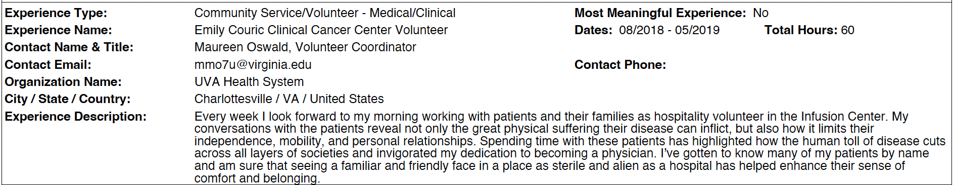

Slide 4
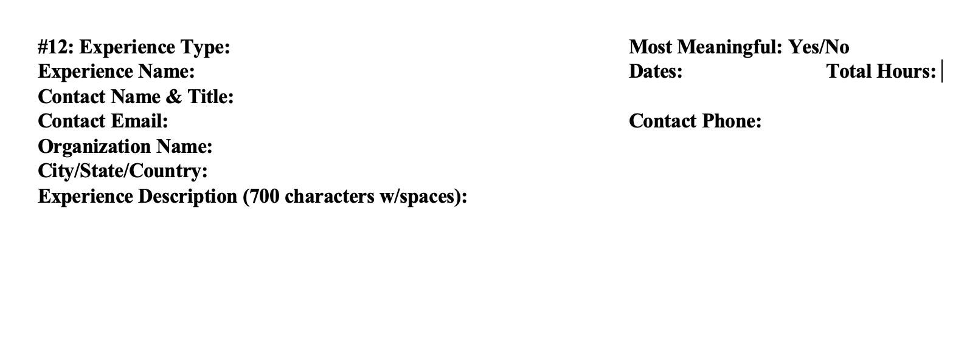

Slide 5
What to write?
Do not repeat your Position, Organization, Location, Time…
  Ex: I worked as a Pre-Med advisor at University of Virginia in Charlottesville, VA from 2016-2024.
  All of this information is already stated before beginning the Description!
What did you do?
  I observed Dr. P meet patients with A, B, and C issues. Afterwards, we discussed their diagnosis. I helped the nurses do Q, R, and S.
Why did you want to do this?
  I was interested in ______ specialty because _______.
What did you learn?
  After observing Dr. G work with Patient H, I realized X,Y, and Z about practicing medicine.

Slide 6
Most meaningful experiences
You’ll input up to 15 Experiences total
You can select 3 of your 15 experiences to be “Most Meaningful”
For these 3, you get an additional 1325 characters with spaces to describe why it was so meaningful.

Slide 7
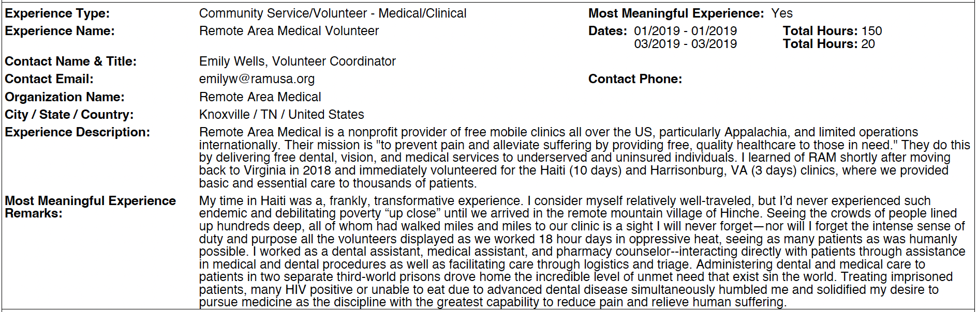
Most meaningful example
700 characters w/ spaces →
1325 characters w/ spaces →

Slide 8
Identifying the “most” MEANINGFUL
What experiences are you most proud of?
If you only got to tell the Admissions Committee about 3 of your Experiences, which 3 would you pick?
These do not all need to be medically or clinically related.

Slide 9
Writing the most MEANINGFUL comments
Use the 700 characters to describe the Experience.
Use the additional 1325 characters to describe why it was so meaningful.
What do you remember most about these experiences?
Any memorable anecdotes, patients, students, etc?
Why did these experiences stick with you in such a special way?

Slide 10
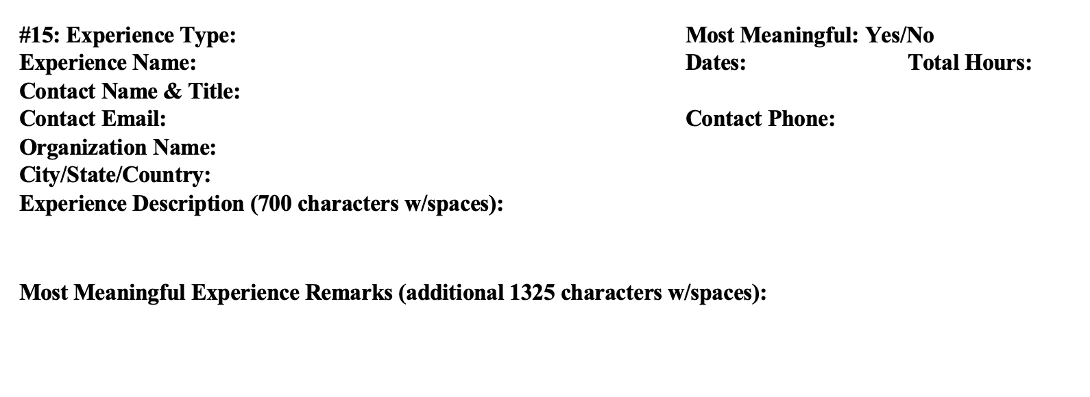
MOST MEANINGFUL EXPERIENCE

Slide 11
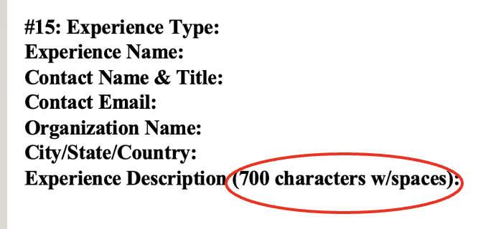
Experience types
Artistic Endeavors
Community Service/Volunteer - Medical/Clinical
Community Service/Volunteer - Not Medical/Clinical
Conferences Attended
Extracurricular Activities
Hobbies
Honors/Awards/Recognitions
Intercollegiate Athletics
Leadership - Not Listed Elsewhere
Military Service
Paid Employment - Medical/Clinical
Paid Employment - Not Medical/Clinical
Physician Shadowing/Clinical Observation
Presentations/Posters
Publications
Research/Lab
Social Justice/Advocacy
Teaching/Tutoring/Teaching Assistant
Other

Slide 12
labeling YOUR EXPERIENCE TYPE

Slide 13
AAMC core Competencies
Professional | Science | Thinking & Reasoning
Commitment to Learning & Growth Cultural Awareness Cultural Humility Empathy & Compassion Ethical Responsibility to Self & Others Interpersonal Skills Oral Communication Reliability & Dependability Resilience & Adaptability Service Orientation Teamwork & Collaboration | Human Behavior Living Systems | Critical Thinking Quantitative Reasoning Scientific Inquiry Written Communication
Notes:
AAMC (again) – evaluation of candidates – how the program provides opportunities to demonstrate/develop/grow in these areas

Slide 14
Next Steps
Experiences wORKSHEET:
Rough Draft
sCHEDULE AN aDVISING aPPT
Complete the Experiences Worksheet found in Canvas
Upload a Word or Google doc (no Excel sheets, please!)
Once complete/uploaded to Canvas, schedule an Advising Appt with your advisor.

Slide 15
qUESTIONS?
Email us at postbac@virginia.edu
Schedule an appointment with an advisor: https://www.uvapbpm.com/advising

